Slide 1
How to Interpret Midterm Feedback Surveys

Slide 2
Question 1: Overall Effectiveness
In the rest of the survey,
Blue indicates responses from students who said the course was “Excellent”
Orange indicates responses from students who said the course was “Good, but could be improved”
Red indicates responses from students who said the course “Need significant improvement in multiple areas”

Slide 3
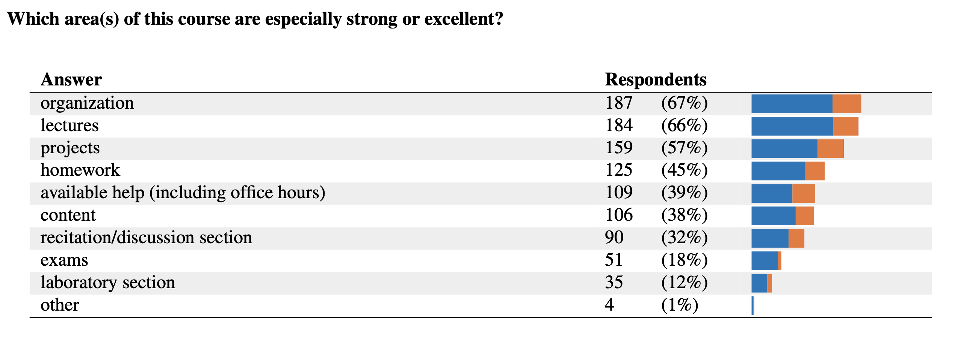
Example Color-Coding
Of the 187 respondents who selected “organization” as one of their answers, most rated the course as “Excellent” on Question 1, and some as “Good”.

Slide 4
Example Response Breakout
Respondents were able to select multiple answers.
187 out of 276 chose “organization” as one of their answers.
Rounded down, that is 67% of respondents.
Percentages add up to more than 100%, because respondents could pick multiple answers.

Slide 5
Example Free Text Response
Responses from students who said course is “Excellent”
Unique pseudonym for student in this course; consistent across the report to correlate comments; changes between courses
Responses from students who said course is “Good”

